Slide 1

Computer Graphics
Rayhan Ahamed
ID : 011142141
Rakib Hasan Suvo
ID : 011142016

Slide 2
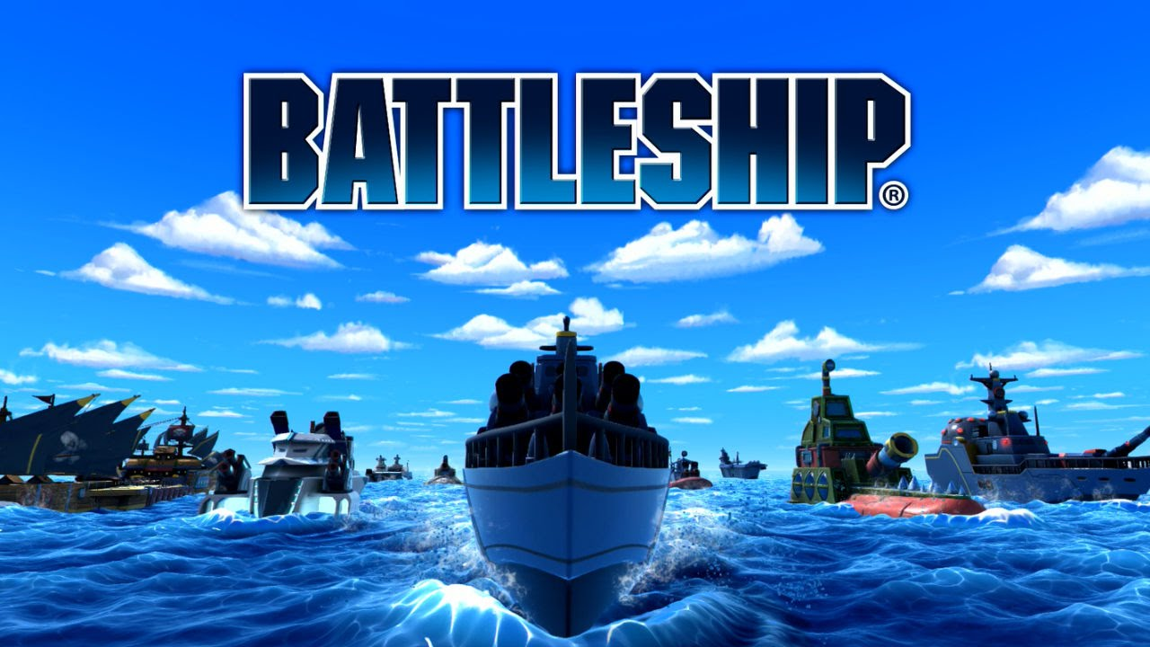

Slide 3

Project Over View
It’s a simple 2D C++ project.where we can build a ocean scenario,Some boats,and enemy boats are attack battle boat and battle boat save from enemy missile and gain score and when certain score are increase get level up enemy missile.(A battle boat and some enemy boats) on the ocean,Hills on the Ocean side,moving clouds and so on.

Slide 4

Individual Contribution
Rayhan Ahamed
Sun,Hill,Cloud,River,Boat,Water,Missile
Rakib Hasan Suvo
Score Count, Collision Check,Update ,Game Over

Slide 5
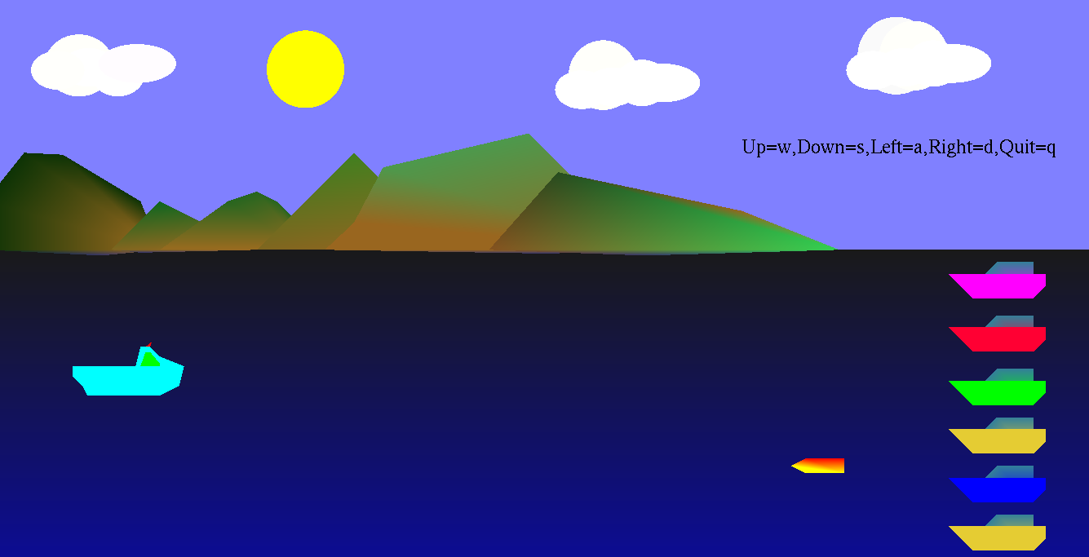
Screen Shots

Slide 6


